Slide 1
Lab C: Vitis Vision Library
Homography Warpping
Team 4
Date: 2021/11/29
https://github.com/Yuoto/labC

Slide 2
Overview
Homography and Warping
Kernel Code
Kernel Optimization
Benchmark
Application Demo
Appendix

Slide 3
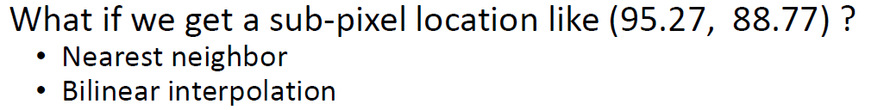
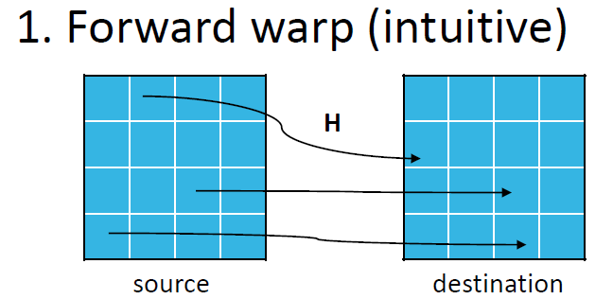
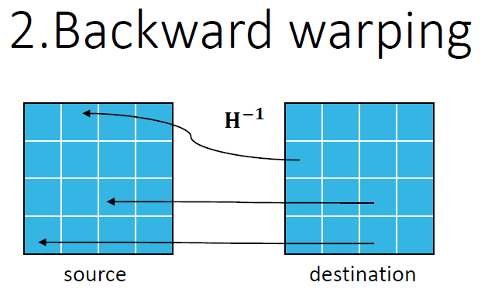
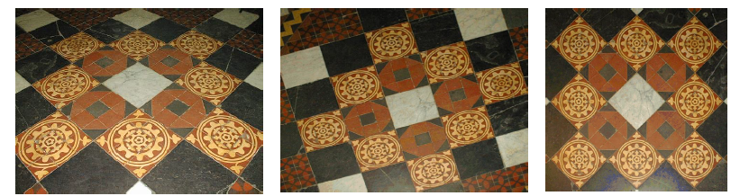
Warping
Per-pixel transforming problem
Transform by matrix multiplication

Slide 4
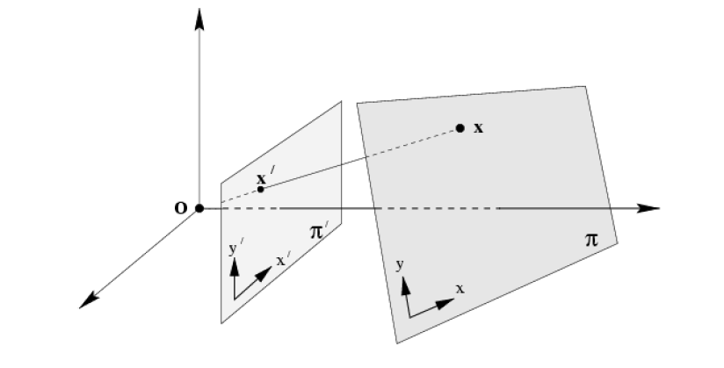
Homography(1/2)
Mapping between planes
Planar pose estimations

Slide 5
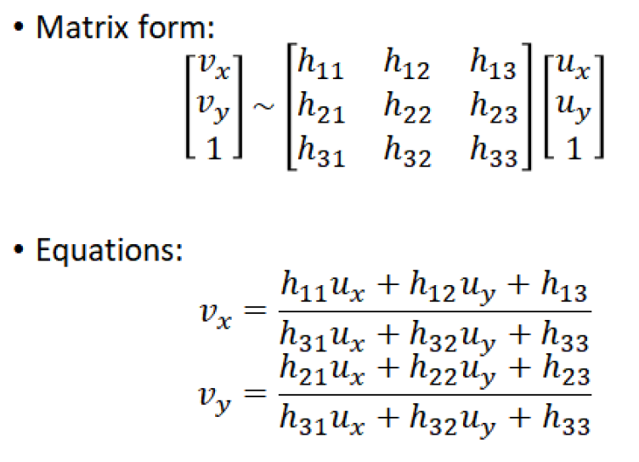
Homography(2/2)
Per-pixel matrix multiplication problem

Slide 6
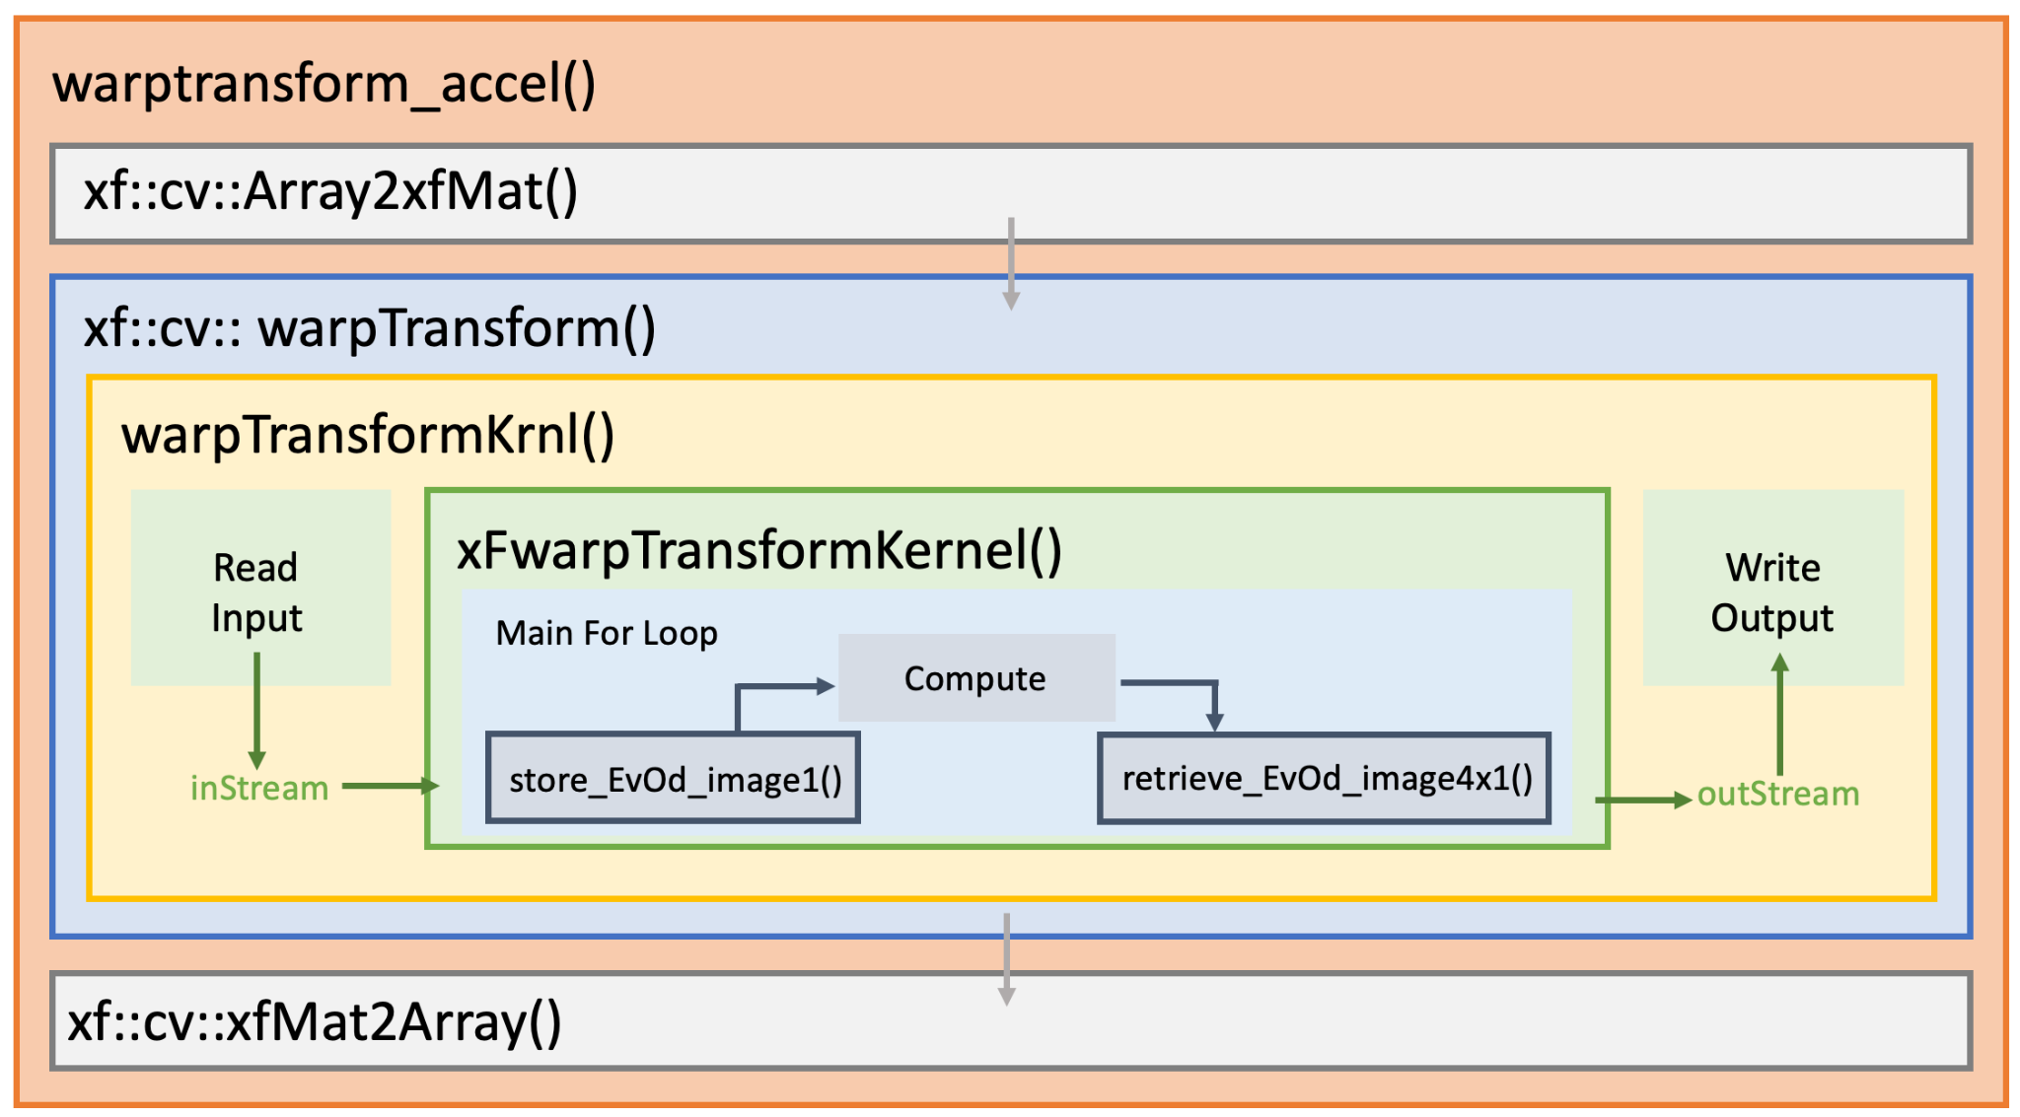
Kernel Code

Slide 7
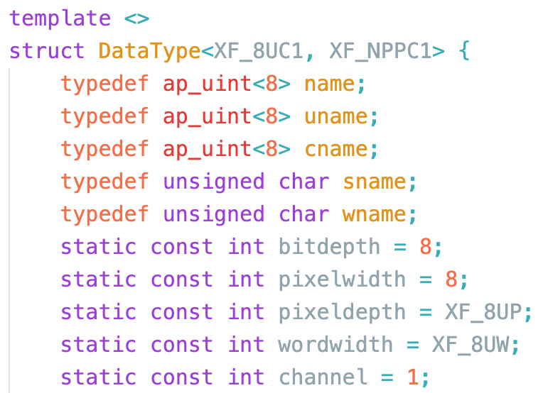
Kernel Code － Data Type
Pixel Type
Pixel-Level Parallelism
 | Option | #bits per Pixel | #Channels
Gray | XF_8UC1 | 8 | 1
RGB | XF_8UC3 | 8 | 3
Option | Description
XF_NPPC1 | Process 1 pixel per clock cycle
XF_NPPC2 | Process 2 pixels per clock cycle
XF_NPPC4 | Process 4 pixels per clock cycle
XF_NPPC8 | Process 8 pixels per clock cycle

Slide 8
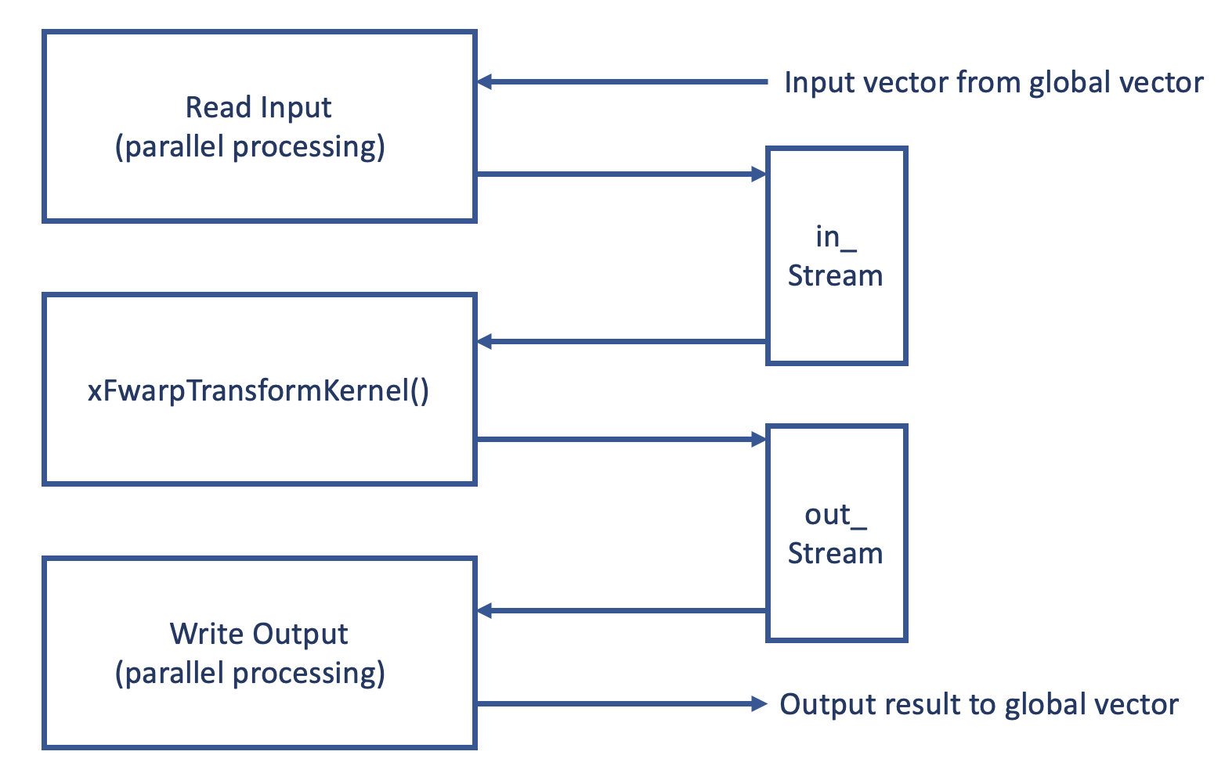
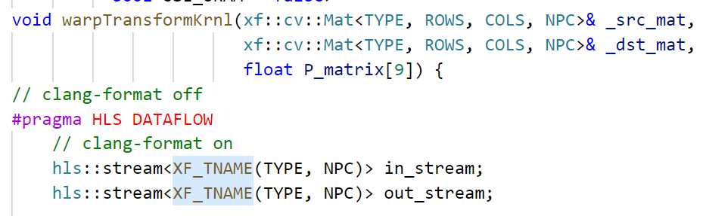
Kernel Code － I/O Stream
DATAFLOW
XF_BITSHIFT(NPC): Pixel-Level Parallelism

Slide 9
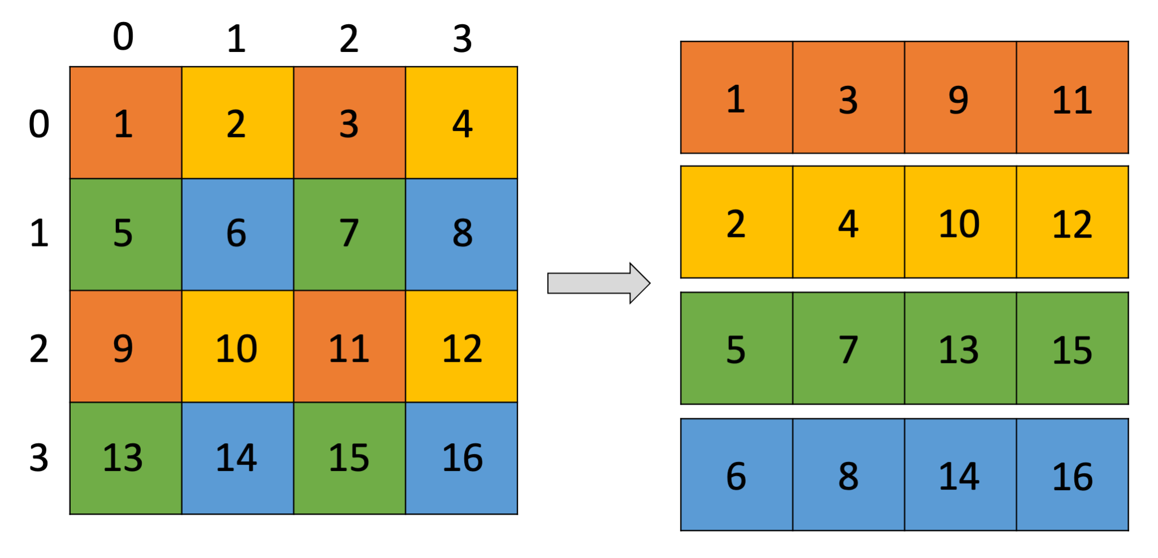
Kernel Code － Buffer (1/2)
4 memory blocks
Bilinear Interpolation
Assign each pixel to one memory according to the parity of its column and row

Slide 10
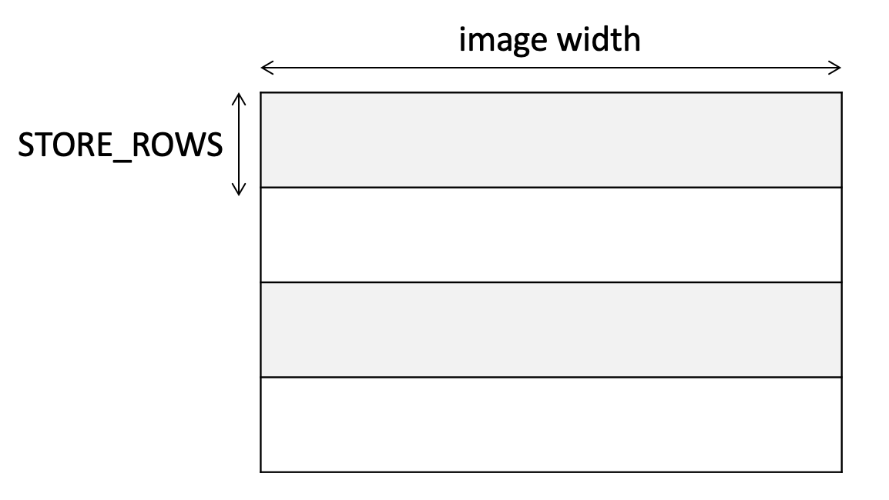
Kernel Code － Buffer (2/2)
4 memory blocks
1 block size: STORE_ROWS/4 x image width
Write one pixel per cycle
Start to overwrite the buffer if the index of executed row > STORE_ROWS
If the pixel is not in the buffer, write 0 to output stream instead.

Slide 11
Kernel Code － Backward Warp
2-level nested loop
Loop bound:
1st (img_rows + START_ROW)
2nd image width
Steps
Store input image to buffer
Compute which pixel of input image should be outputted after START_ROW
Bilinear Interpolation
Retrieve that pixel from buffer

Slide 12
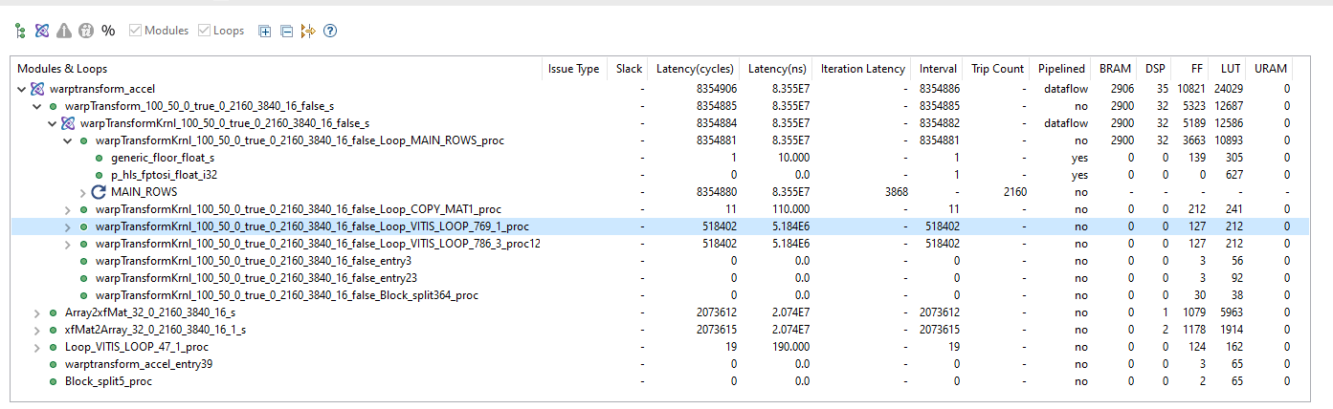
todo: Kernel Optimization
Although there exists SIMD-like parallelism
Loop bound of the main loop is fixed to UHD
UHD 3840*2160

Slide 13
Benchmark: 4K UHD Gray/ RGB
Single Shot
Workstation CPU
auto start = std::chrono::high_resolution_clock::now();
std::chrono::duration_cast<std::chrono::milliseconds>(std::chrono::high_resolution_clock::now() - start).count()
 | 4K Gray | 4K RGB
CPU | 373 ms
FPGA kernel | 29.16 ms
FPGA data transfer | 9.14/0.86 ms

Slide 14
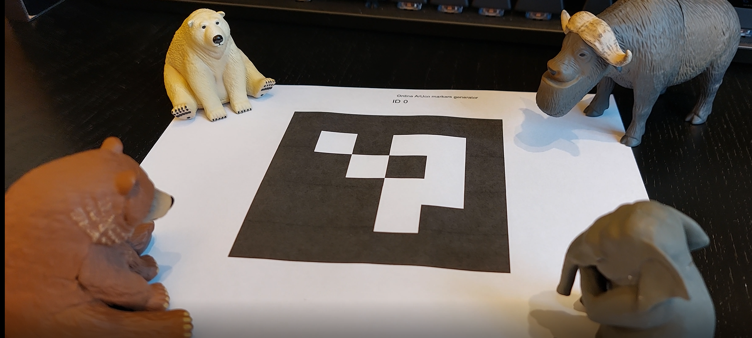
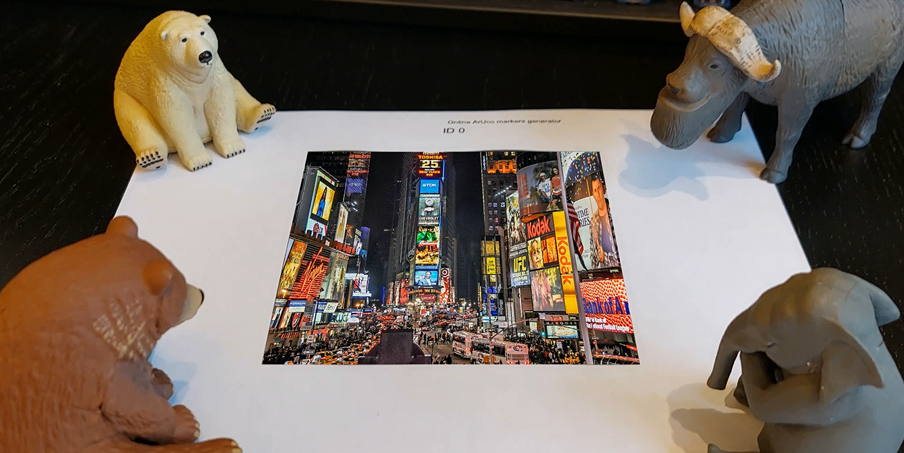
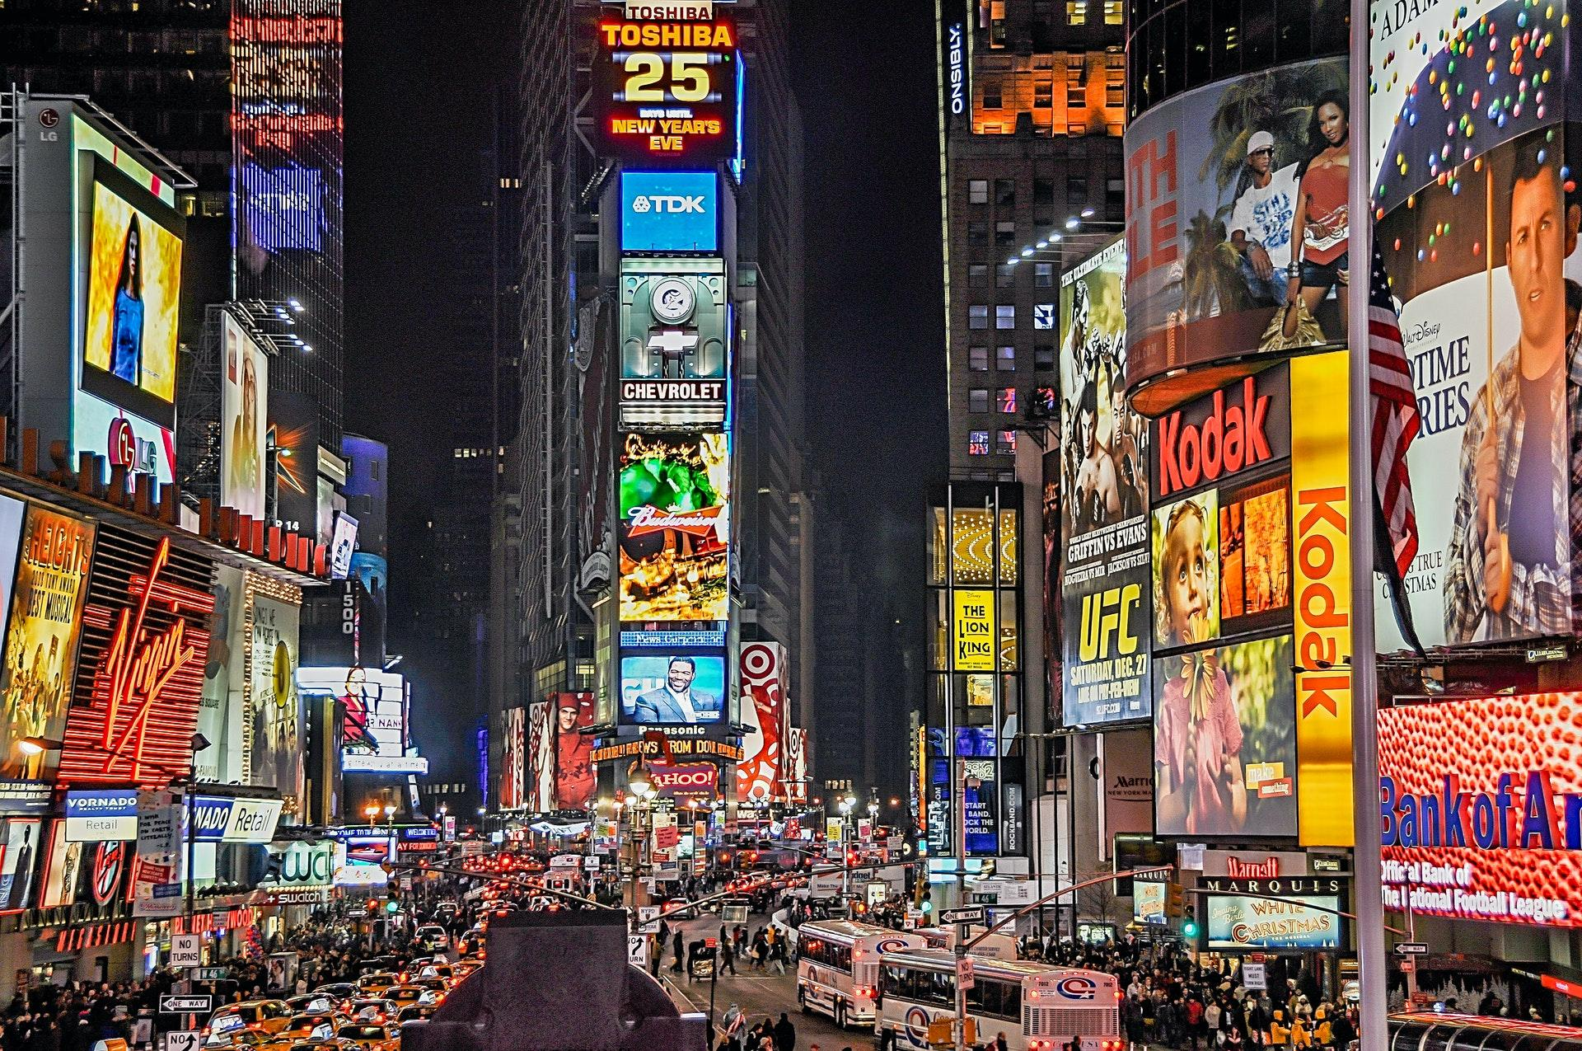
Application Acceleration
Marker Detection
Homography Estimation
Inverse warp
Template

Slide 15
Appendix: Add Library in GUI
Similar as Visual Studio
Compile from source or pre-compiled binary
Add include file, library path, symbol to project properties
Eigen, Boost, OpenGL, … etc

Slide 16
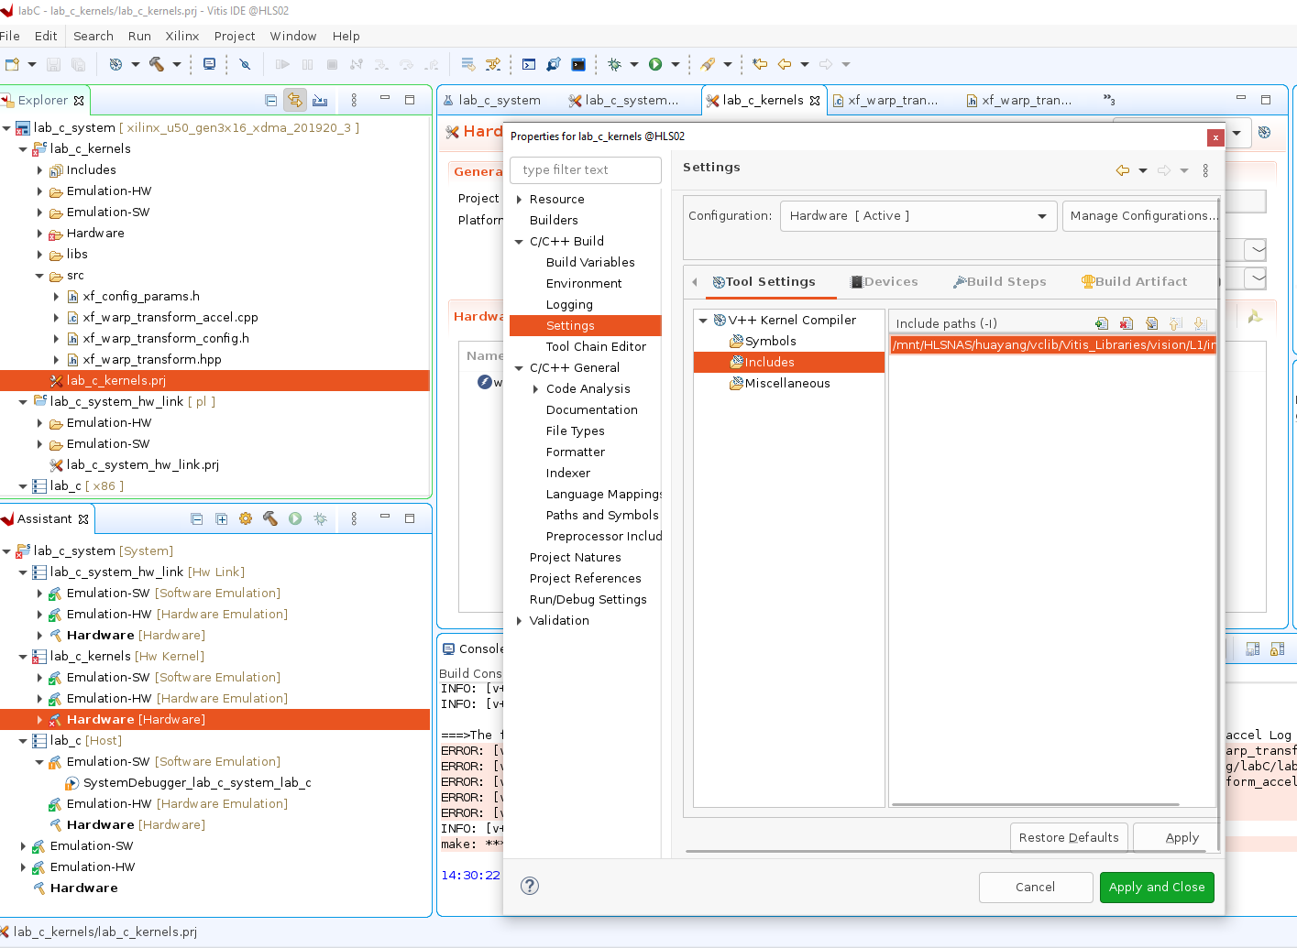

Slide 17
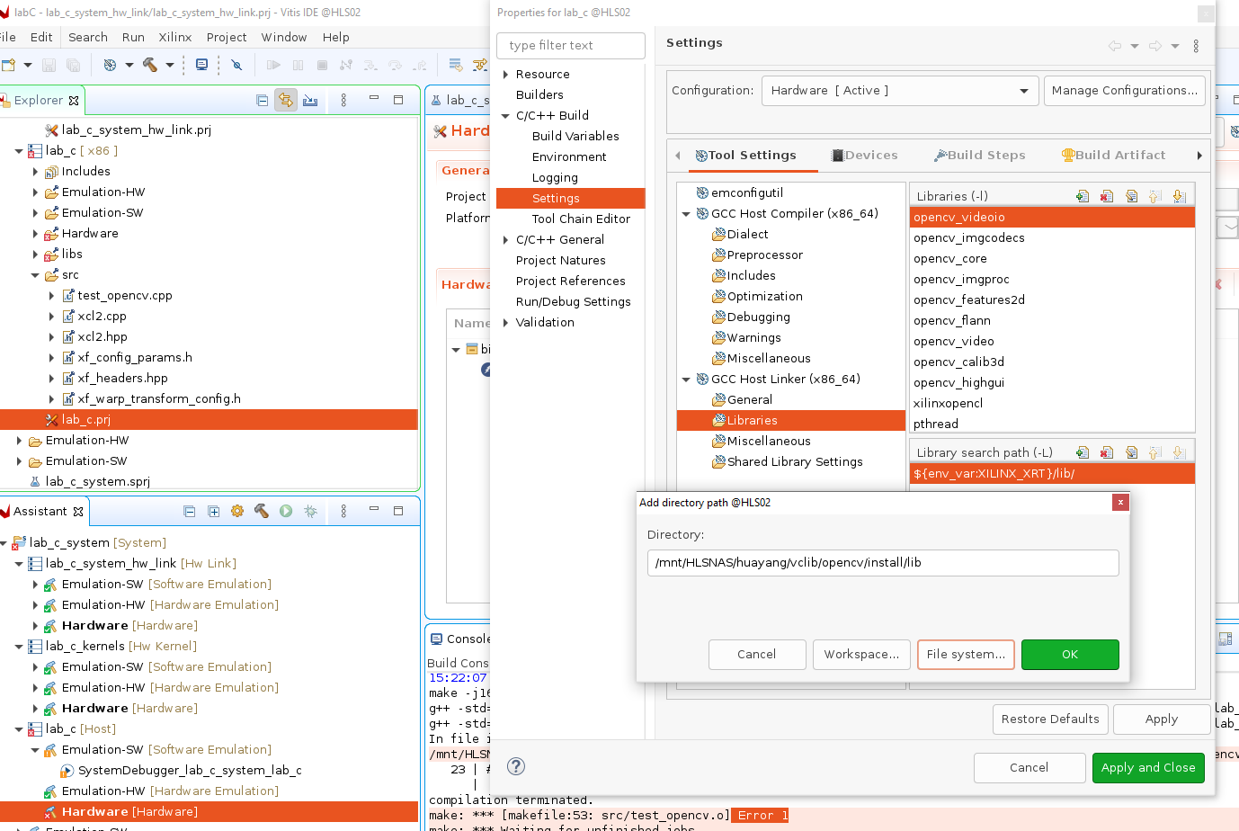

Slide 18
Summary
Application acceleration design in Vitis
Design memory array storage for certain algorithm
Library import in GUI mode

Slide 19
TODO
Add benchmark to 4K UHD RGB video stream input
Optimize the main loop

